Slide 1



Poe injector
Parman company – first demo 03/05/17
Mentor : mrs shaterzade members: arezoo savlani, mehrad afshari nazari

Slide 2
Introduction
Description and objectives
PoE
PoE Injector
Control board

Slide 3
Description and objectives
Project Description:
This project involves the design of a plug-in electronic board that performs control and management functions for a main PoE injector board. The plug-in board includes a microcontroller responsible for generating and managing I2C, UART, and NPI signals to interact with and control the PoE controller chip on the main board. The primary objective is to enhance the operational capabilities and streamline the control processes of the PoE injector system.
Goals and Objectives:
-Develop a plug-in board capable of efficiently managing the PoE injector main board's operations.
-Create a modular plug-in board that can be easily attached or detached from the main PoE injector board.

Slide 4
Poe and poe-injector
What is PoE?
Power over Ethernet (PoE) is a technology that enables Ethernet cables to carry electrical power, along with data, to remote devices. This allows for the simplification of installations by eliminating the need for separate power supplies or electrical outlets for devices such as IP cameras, VoIP phones, wireless access points, and other network devices.
How PoE Works
PoE delivers power in a method similar to how data is transmitted over Ethernet cables. It uses two pairs of the standard twisted pairs in a Cat5 or higher Ethernet cable. There are two primary standards for PoE:
IEEE 802.3af (PoE):
Provides up to 15.4 watts of power over Cat5 cables.
Uses two pairs of wires within the cable.
Ideal for devices that require low to moderate power, such as IP phones and small cameras.
IEEE 802.3at (PoE+):
Provides up to 25.5 watts of power.
Uses all four pairs of wires within the cable.
Suitable for devices with higher power needs, such as PTZ cameras and advanced wireless access points.

Slide 5
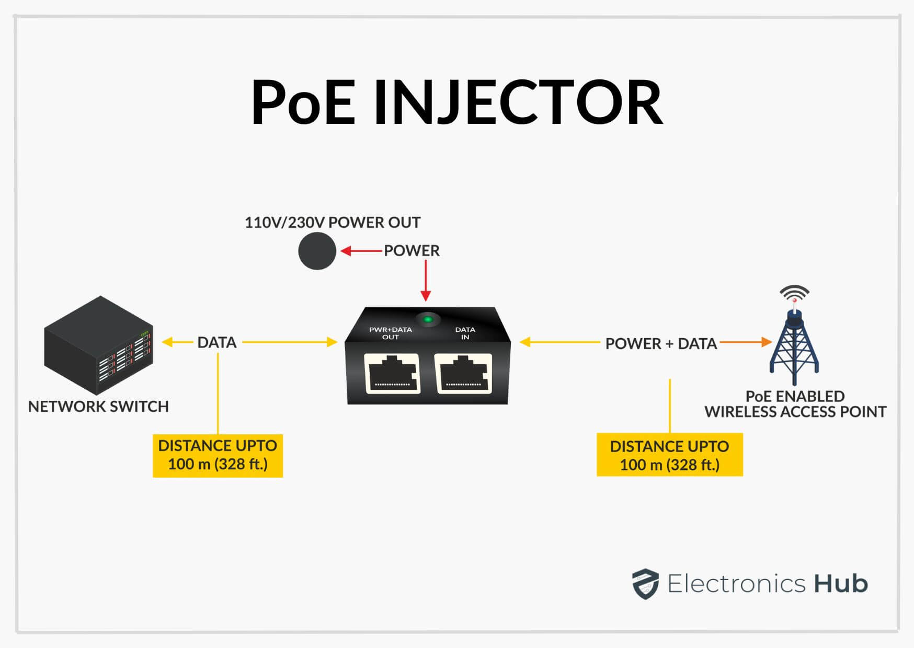
Poe and poe-injector
Key Components of PoE
Power Sourcing Equipment (PSE):
Devices that provide the power. Examples include PoE switches and PoE injectors.
Powered Devices (PD):
Devices that receive the power. Examples include IP cameras, VoIP phones, and wireless access points.
POE Injector :
If our switch is not POE, we can use POE-injector to unify power and data and send it to the device. In this way, it takes the power from the socket with the plug and receives the data from the POE-Non switch with the Lan port, and by using the POE port, we can receive the data and power output and send it to the device.

Slide 6
Poe and poe-injector
Types of PoE based on the type of power application:
Active
Passive
Benefits of Using a PoE Injector
Flexibility:
Allows placement of powered devices in locations without access to electrical outlets.
Cost-Effective:
Reduces the need for extensive electrical wiring and installation.
Simplicity:
Simplifies the setup process by combining data and power into a single cable.
Scalability:
Facilitates easy expansion of network infrastructure by adding PoE capabilities to non-PoE network switches.

Slide 7
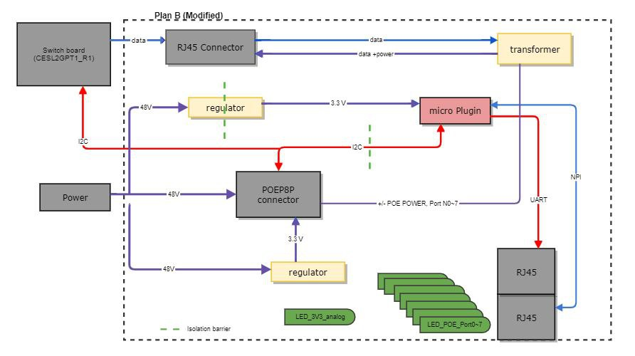
Control board
Block diagram

Slide 8
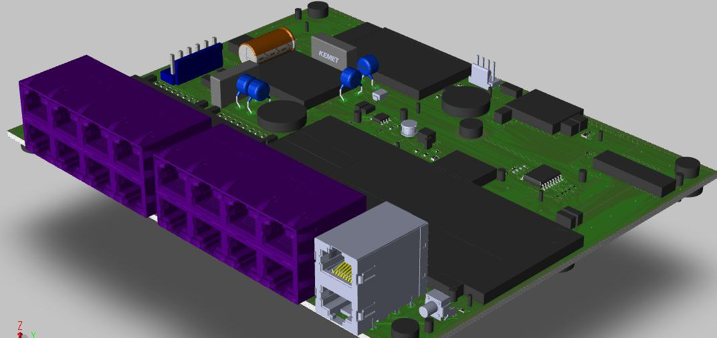
Control board
3D model of PCB Board

Slide 9
Proposed solution
plug in board
Block Diagram
Protocols
ICs

Slide 10
plug-in board
Description:
This board is designed to enhance the performance of the PoE main board by utilizing a microcontroller.
Key features :
Ability of programming
Supporting I2C and UART protocols for monitoring and controlling PoE board.
Supporting RMII protocol for connecting to PHY layer
External reset
NPI
The board consists of four sections:
MCU
Ethernet Path
Communication Path
port

Slide 11
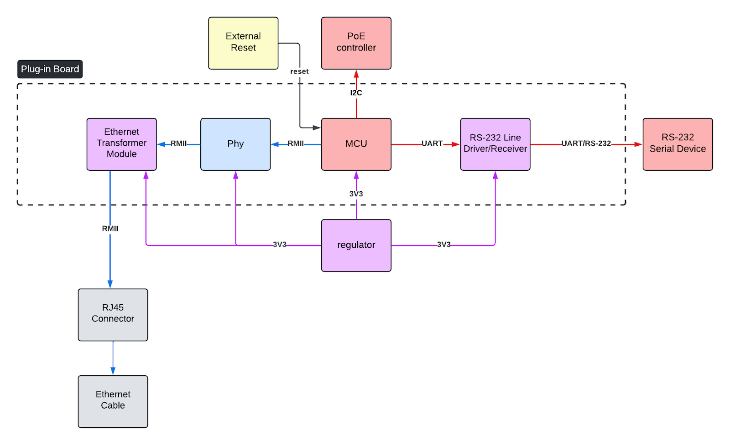
plug-in board
Block Diagram

Slide 12
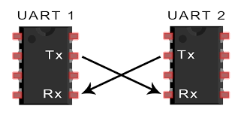
Protocols - UART
How It Works:
Asynchronous Communication
Full-Duplex Transmission
Two-Wire Interface
TX (Transmit Line)
RX (Receive Line)
Start and Stop Bits
Parity Bit (Optional)
Baud Rate
Data Framing
Flow Control
Hardware Flow Control (RTS/CTS)
Software Flow Control (XON/XOFF)
Error Detection
Advantages:
Simplicity
Full-Duplex Capability
Low Pin Count
Flexibility
Wide Usage
Cost-Effective
Asynchronous Operation
Easy Implementation
Robust Error Detection
Compatibility

Slide 13
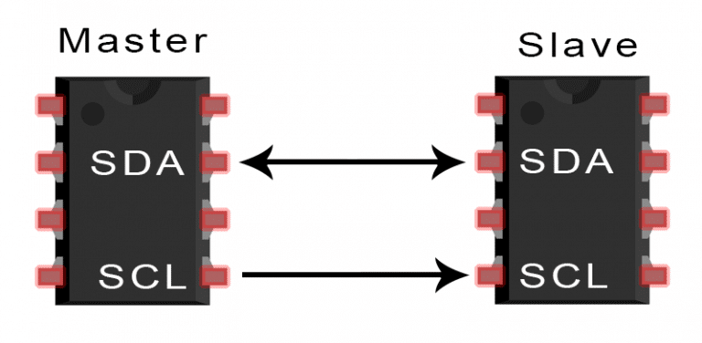
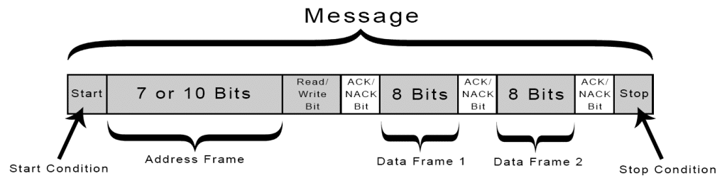
Protocols - I2c
How It Works:
Master-Slave Configuration
Two-Wire Interface
SDA (Serial Data Line)
SCL (Serial Clock Line)
Addressing
Data Transfer
Communication Protocol
Start Condition
Stop Condition
Read/Write Bit
Clock Stretching
Speed Modes
Standard Mode (up to 100 kbps)
Fast Mode (up to 400 kbps)
High-Speed Mode (up to 3.4 Mbps)
Advantages:
Simplicity
Low Pin Count
Flexibility
Scalability
Efficient Communication
Cost-Effective
Synchronization
Widespread Adoption
Multi-Master Capability
Robustness

Slide 14
RMII
RMII (Reduced Media-Independent Interface) Short Description
RMII (Reduced Media-Independent Interface) is an Ethernet interface standard that simplifies the connection between a MAC (Media Access Controller) and a PHY (Physical Layer Device). It achieves this by using a reduced pin count compared to the traditional MII (Media-Independent Interface). RMII utilizes a two-wire interface for data transmission and reception (TX and RX), along with clock signals (REF_CLK for reference clock and CRS_DV for carrier sense and data valid). It supports data transfer rates of 10 Mbps and 100 Mbps with synchronous operation, offering a cost-effective and efficient solution for high-speed Ethernet communication while minimizing board space and power consumption.

Slide 15
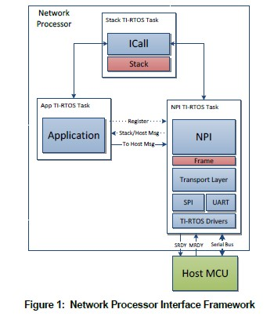
NPI
Advantages of NPI (Network Processor Interface)
Efficient Power Management
Low-Power Operation
Asynchronous Wake-Up
Seamless Communication
Serial Command Handling
Packet Translation
System Integration
Enhanced Responsiveness
Reduced Latency
Flexible Control

Slide 16
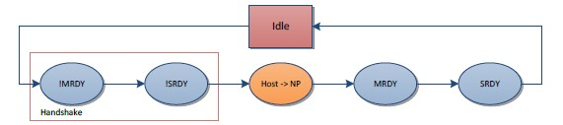
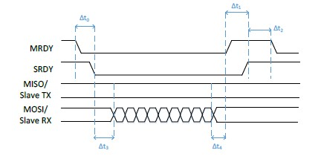
NPI
Hand shaking data transfer (Asynchronous Request (AREQ)):
Example of AREQ Timings

Slide 17
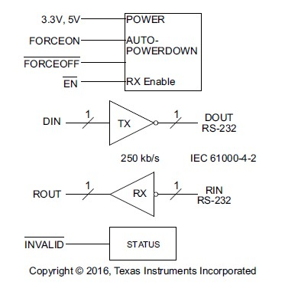
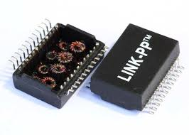
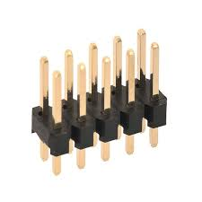
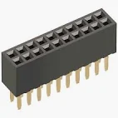
ICs
MCU: STM32F765
Ethernet Path
88E1512-A0-NNP2C000
LP82453NL Transformer
Communication Path: MAX3212E Driver
Port: 2x10 Pin Male/Female Header

Slide 18
Application
What we learned
schematic considerations
Latest schematic design

Slide 19
Project planning
Agile working
Scrum team
Scrum master
Product owner
Project phases and sprints

Slide 20
Agile working
Agile Working: Agile working is a project management approach that emphasizes flexibility, collaboration, and customer-centric development. It involves breaking projects into small, manageable units called iterations or sprints, allowing teams to quickly adapt to changing requirements and deliver incremental improvements. Agile working promotes continuous feedback, frequent reassessment, and adaptive planning, ensuring that products evolve in alignment with user needs and market conditions.
Scrum Team: A Scrum team is a self-organizing, cross-functional group of individuals working together to deliver project outcomes using the Scrum framework. The team typically includes a Scrum Master, a Product Owner, and Development Team members.
Each role has specific responsibilities: the Scrum Master facilitates the process, the Product Owner defines and prioritizes the work, and the Development Team executes the tasks. The team collaborates closely to achieve project goals through iterative development and regular reviews.

Slide 21
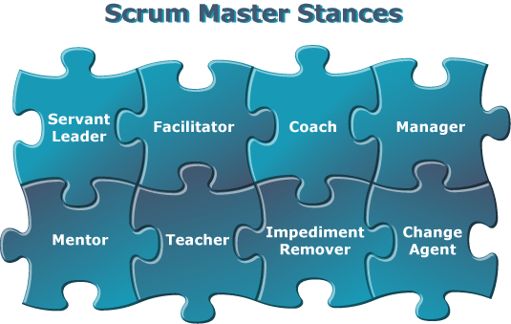
Scrum master
Scrum Master: The Scrum Master is a key role within a Scrum team, serving as a facilitator and coach. They are responsible for ensuring that Scrum practices are properly implemented and followed. The Scrum Master helps the team by removing obstacles that may hinder progress, fostering an environment of collaboration and continuous improvement, and coaching team members on Scrum principles and practices. Their goal is to enhance the team's effectiveness and efficiency in delivering high-quality results.

Slide 22
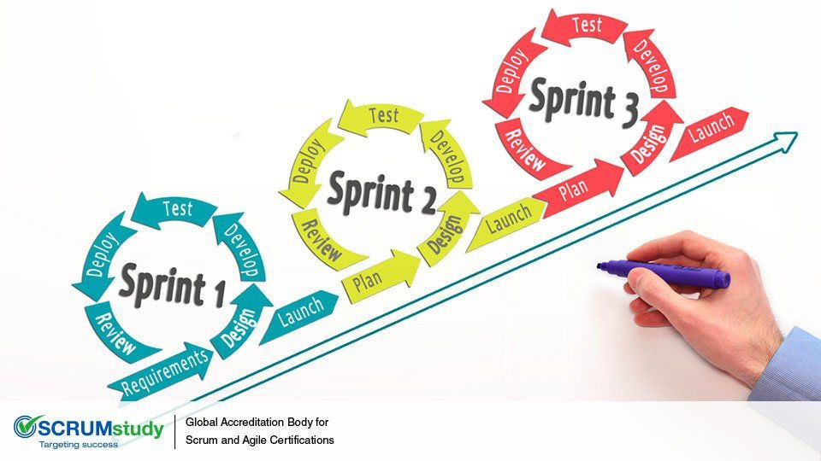


Sprints and to do list

Slide 23
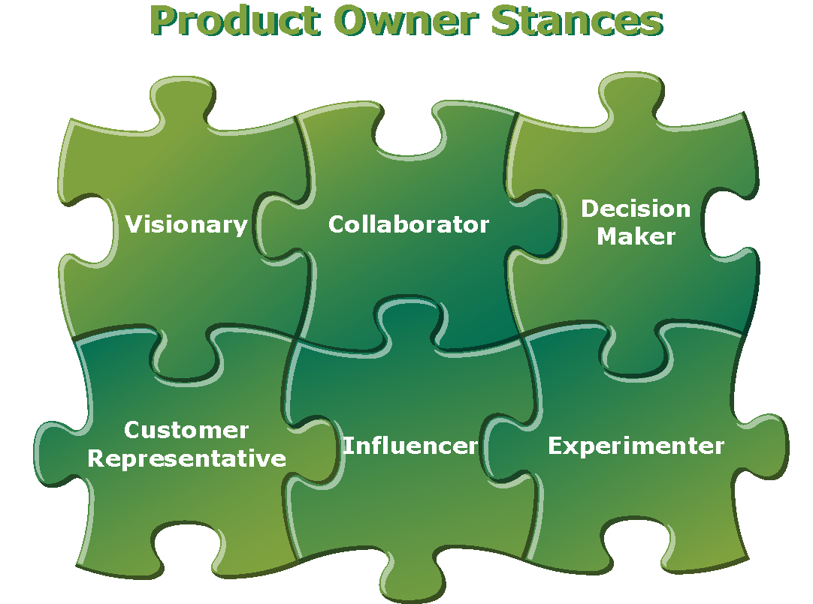
Product owner
Product Owner: The Product Owner is responsible for defining and managing the product backlog, which is a prioritized list of features, enhancements, and fixes for the product. They act as a liaison between the stakeholders (such as customers, users, and business leaders) and the Scrum team, ensuring that the team is working on the most valuable tasks. The Product Owner clarifies requirements, sets priorities, and makes decisions about what to build and when, aiming to maximize the product's value and meet stakeholder expectations.

Slide 24
Thank you!

